Slide 1

FALL 2023
MIS 381N
INFORMATION MANAGEMENT
Final Group Project Presentation
GROUP #: 2
UNIQUE #: 04945
UT McCombs School of Business (MSBA)
The University of Texas at Austin

Slide 2

Group #2
David Gong, Vaishnavi Ganesh, Yash Jain, Sanyam Jain, Vaibhav Nagar
Date: 11/27

Slide 3
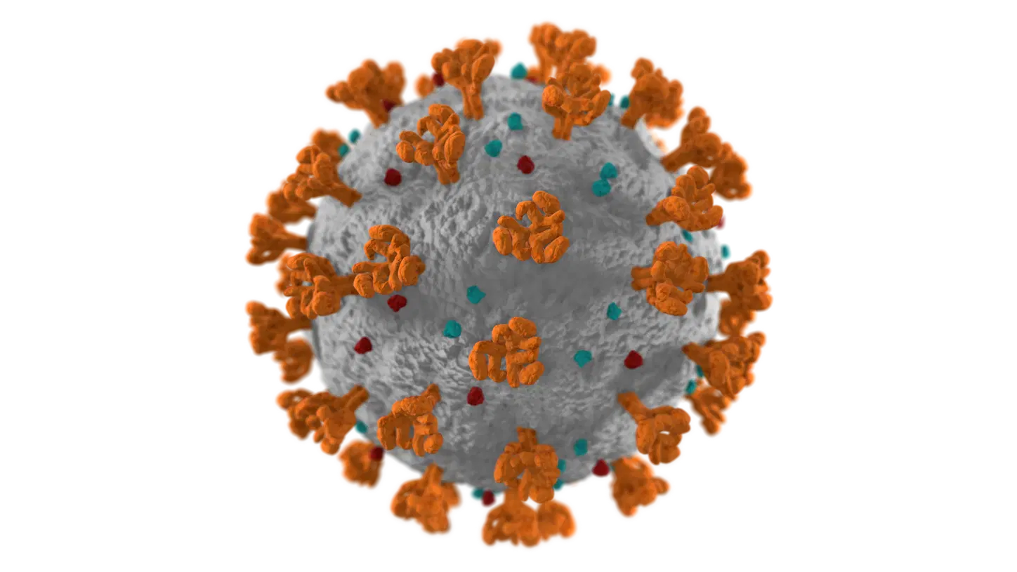
Covid Dataset

Slide 4
Agenda
Introduction
Project Overview
Information Resources
Tools and Technology in use
Data Management Strategy
Challenges
Results/Demo
Ongoing and future steps
Conclusion
Acknowledgement
Notes:
To start off with the agenda: we dive into the project overview and describe about the data, tools and tech we used for this project. We will walk you across the process flow , the challenges we faced and key observations and conclusion.

Slide 5
Introduction
About
Visualizing COVID-19 spread and treatment from 2020-2023
Relevance : Covid was a huge event impacting the entire world
Goal
Provide insights into the spread of the pandemic
Explore various data management tools and techniques
Notes:
The project is about analyzing the spread and preventive measures for covid 19 from 2020-2023. from this we hope we get some insights into the trends of the global pandemic and visualize those tools through various graphs and charts.

Slide 6
Project Overview
Focus:
Visualizing the global spread of COVID-19
Parameters:
Infection rates, Location, and Mortality
Visualisation:
Trends, hotspots, and Measures
Notes:
The parameters we use to track the trends are infection rates , vaccination rates , location based and mortality attributes. And for visualization we check the prevalent covid trends, hotspot location and measures to prevent the spread of the virus.I will now pass it on to David to explain further

Slide 7

Information Sources
Data dimensions: Continents, countries, dates (2020-2023)
Measures: New cases, total cases, new deaths, total deaths, vaccinations, boosters, etc
Huge dataset - over 350k rows and 67 columns
EDA(Python): Missing Values, Fill null Values (Continent), Zeroes, Categorical data, Remove unknown locations

Slide 8



Tools and Technologies
Data storage and NoSQL | Python for data exploration | Tableau for data visualization

Slide 9
Data Management Strategy
Python
(Cleaning)
Cleaned the covid dataset using python
Removed Nulls, fixed granularity and data quality
MongoDB
(DataBase)
Fed the data to MongoDB to create our database
Created a connection to Tableau
Tableau
(Visualization)
Fetched the data from the MongoDB cluster to create dashboards
Derived Insights

Slide 10
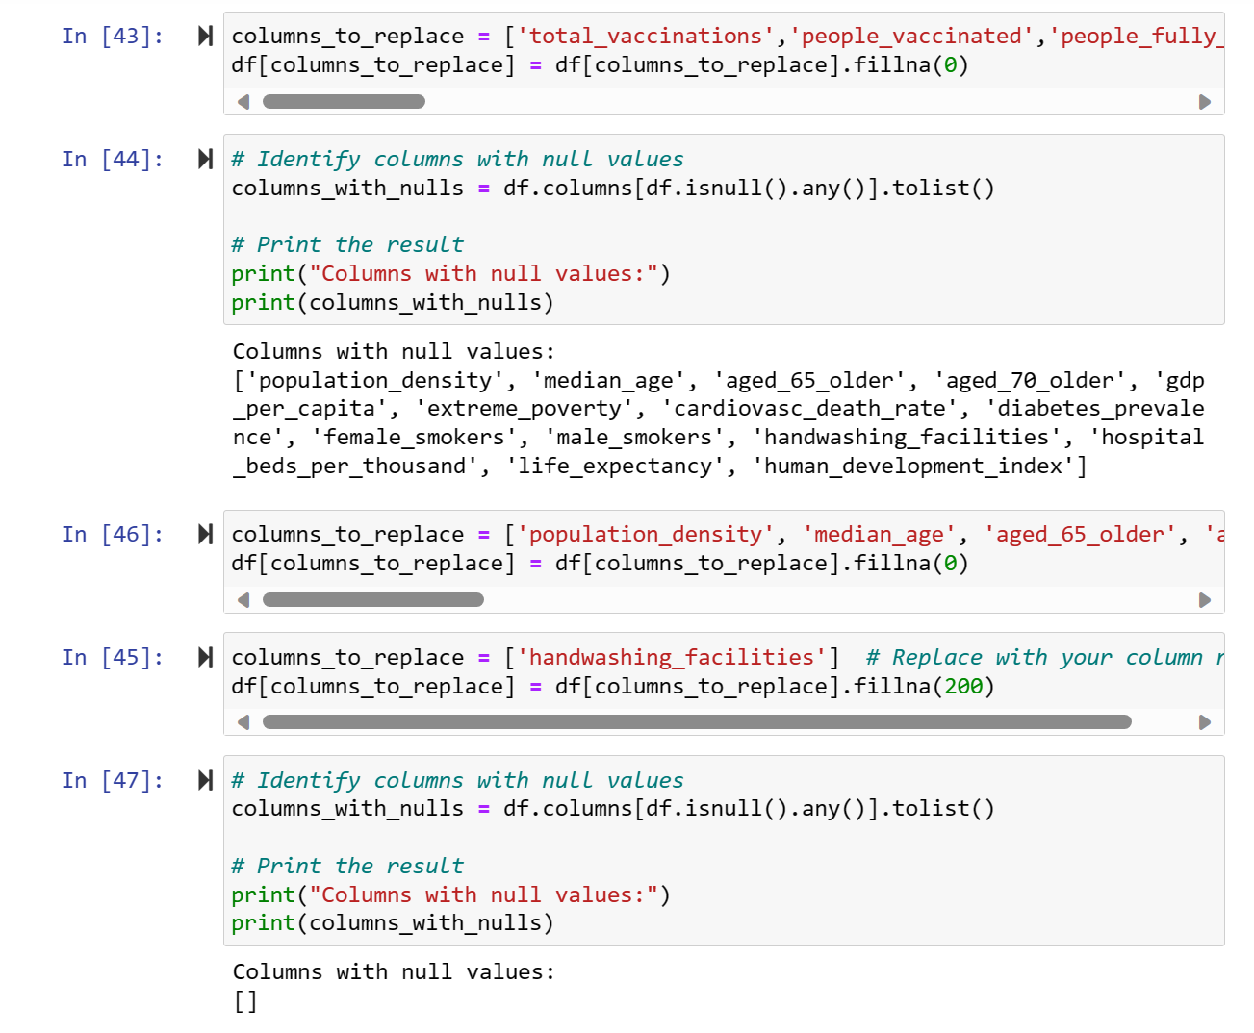
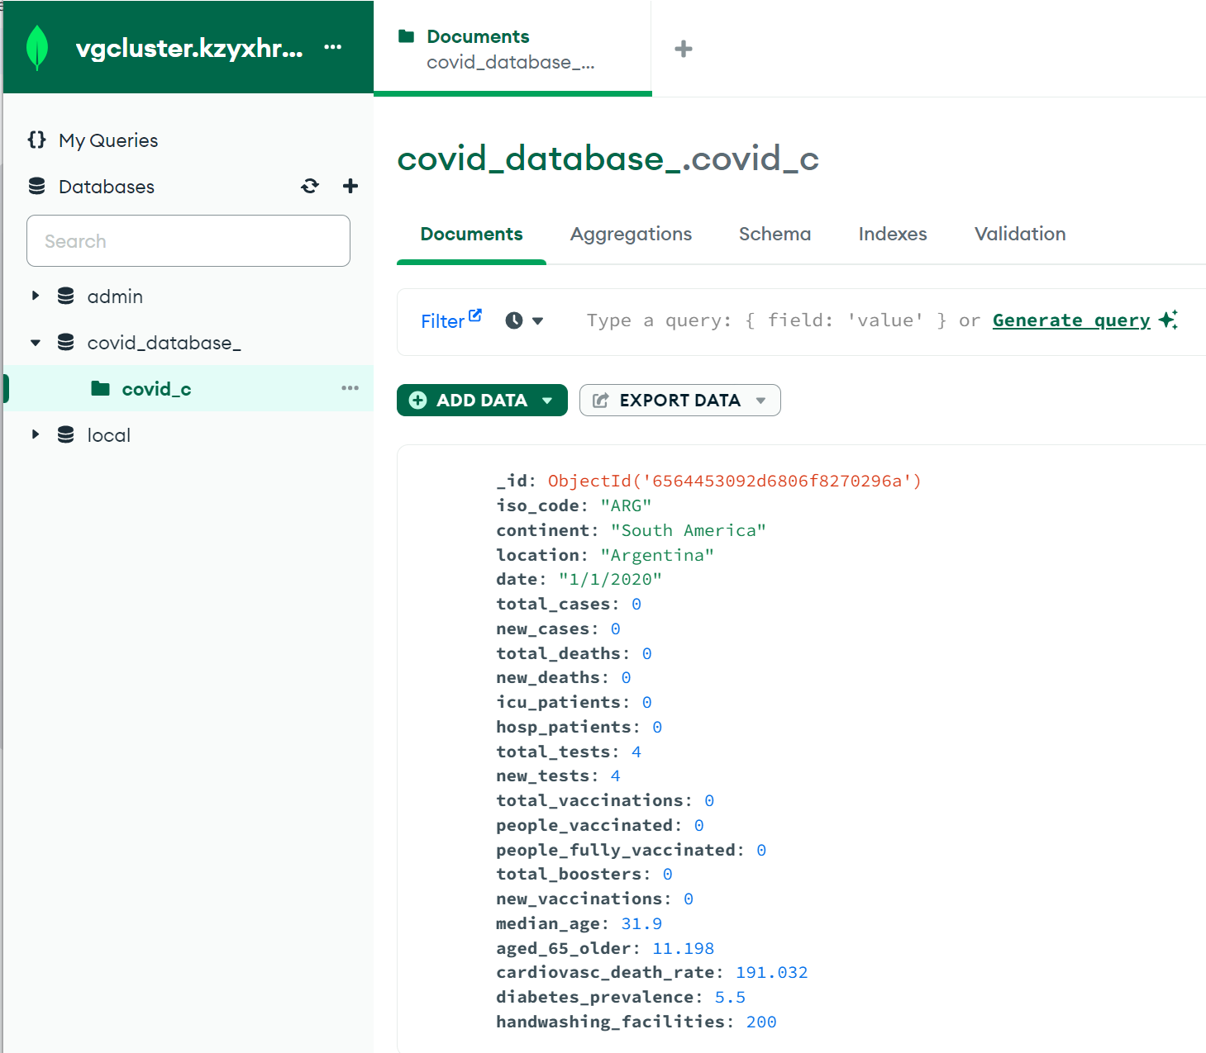
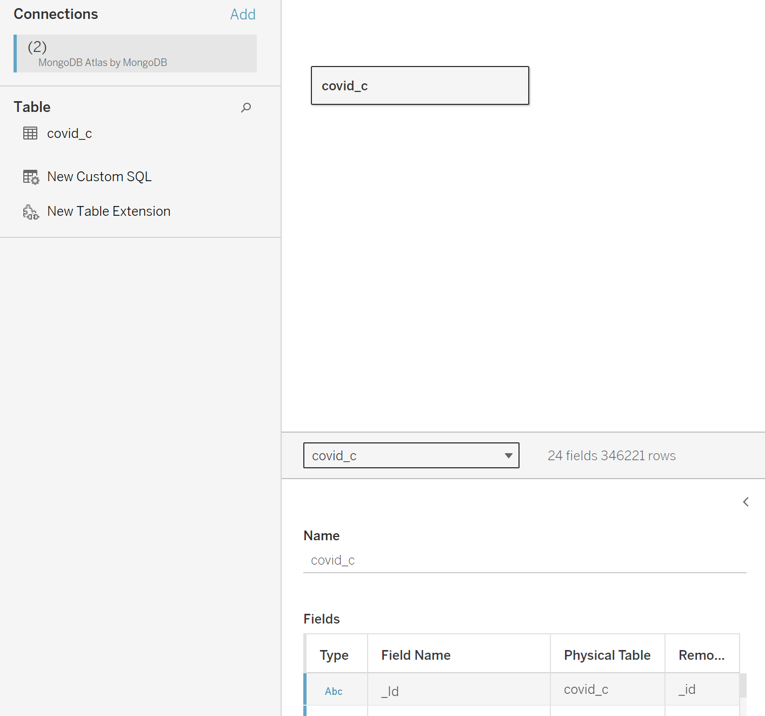
Data Management Strategy
Python
MongoDB
Tableau

Slide 11
Challenges
MongoDB | Connection error JSON File size restriction (16 mb) Not all columns imported to Tableau
Atlas | Licensing issues (Single cluster free) Dashboarding not very seamless
Data | Missing values and Null Continent and location info

Slide 12
Results/Demo

Slide 13
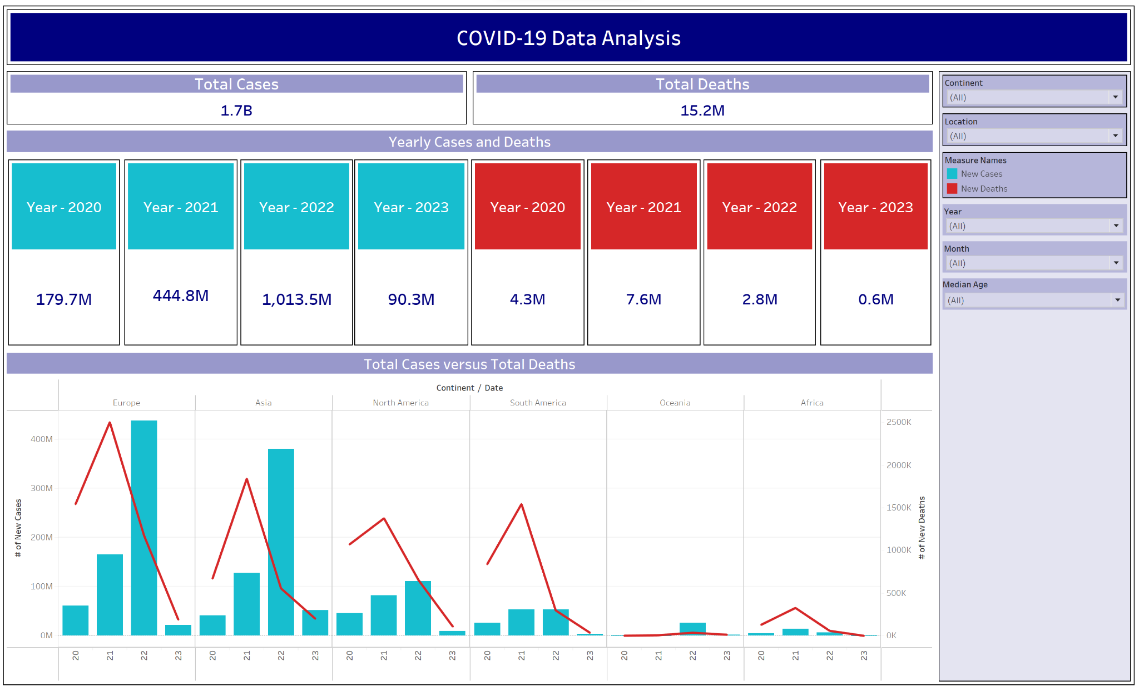

Slide 14
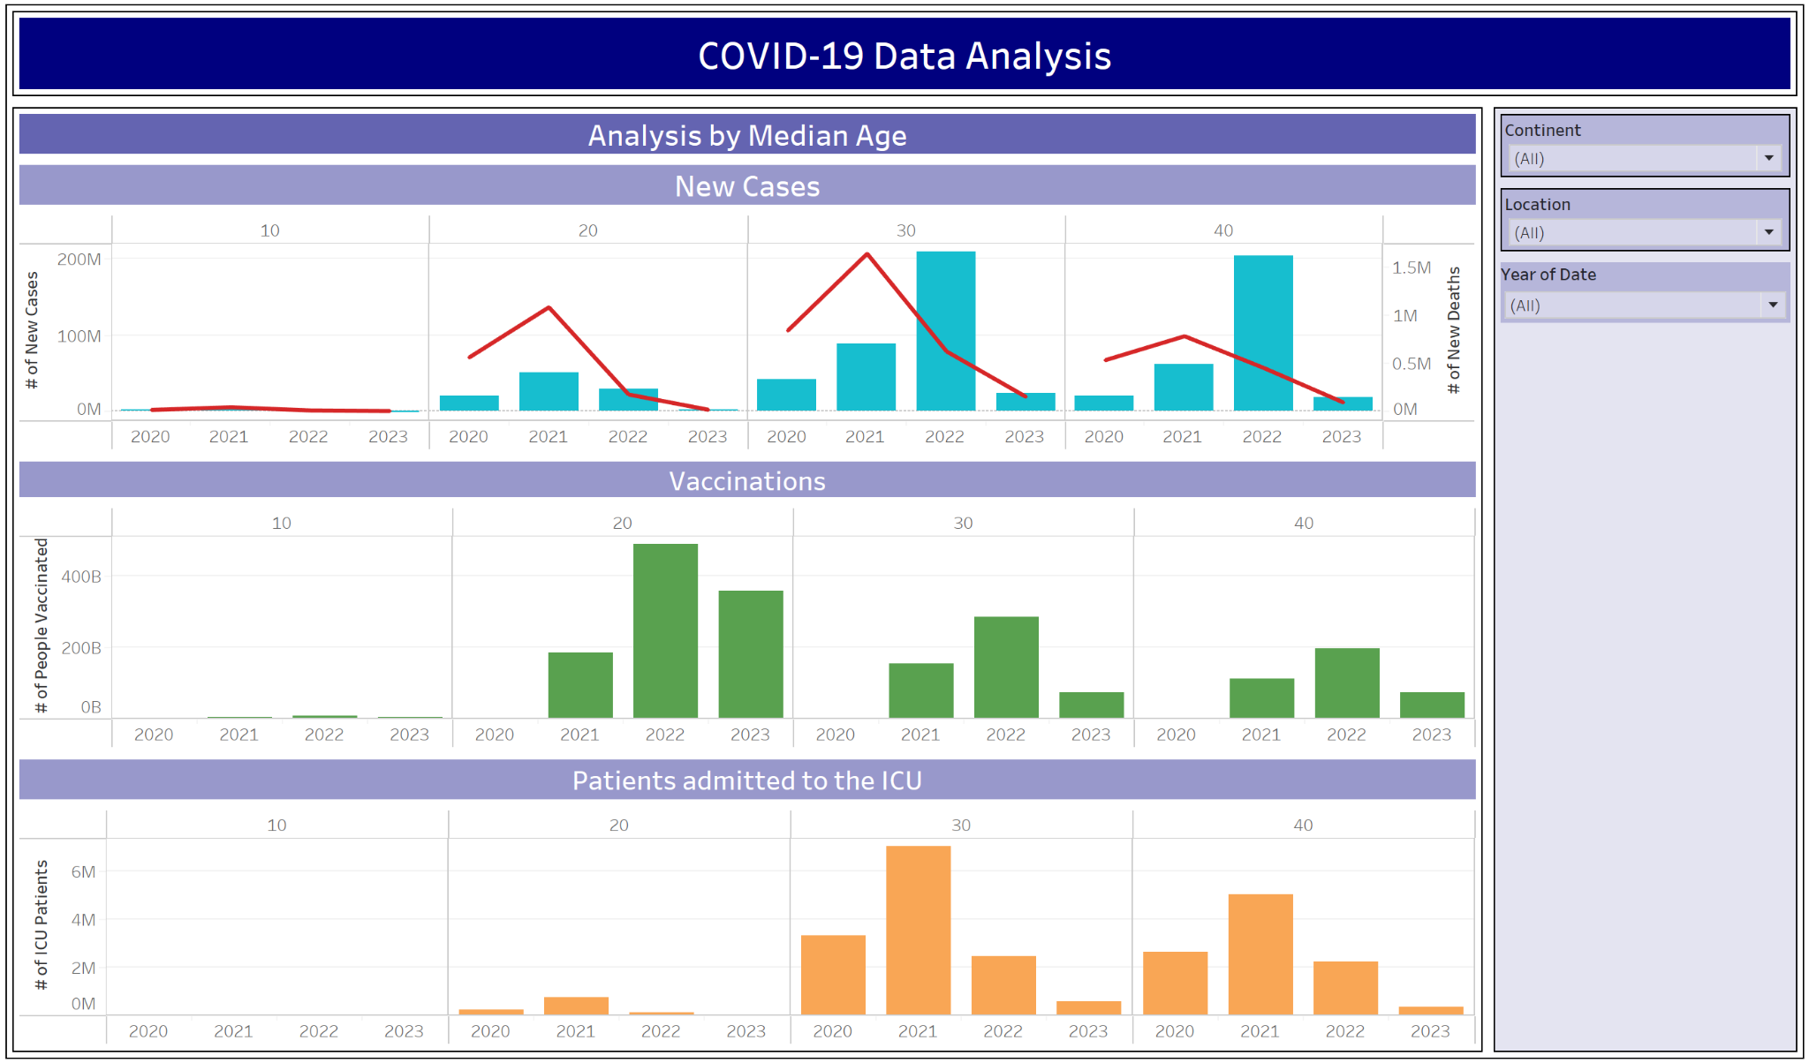

Slide 15
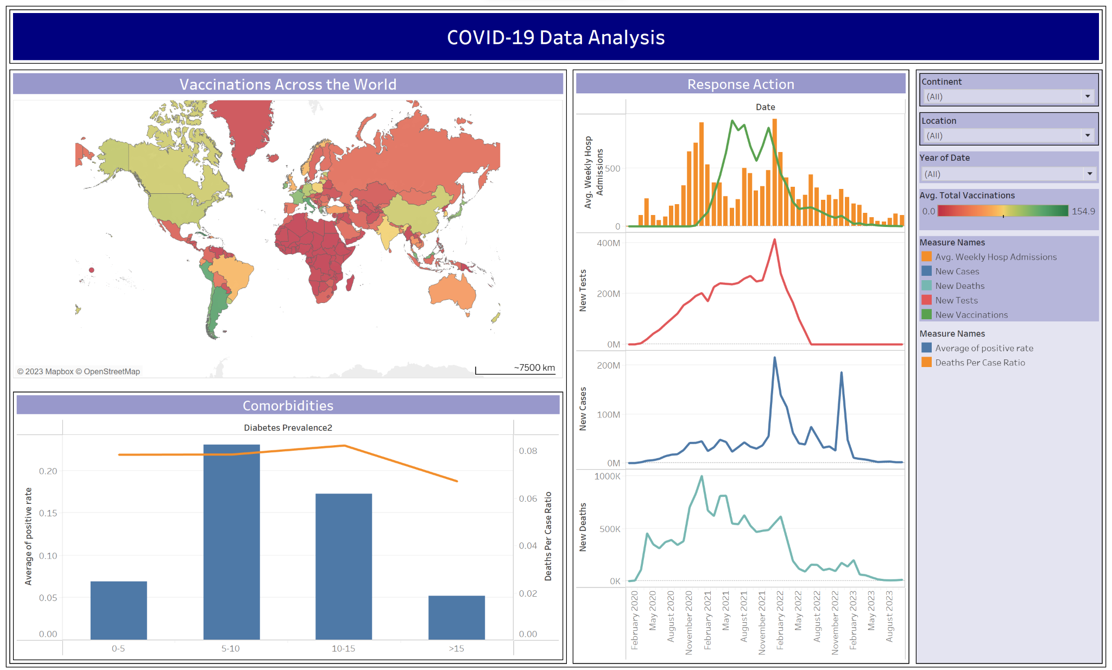

Slide 16


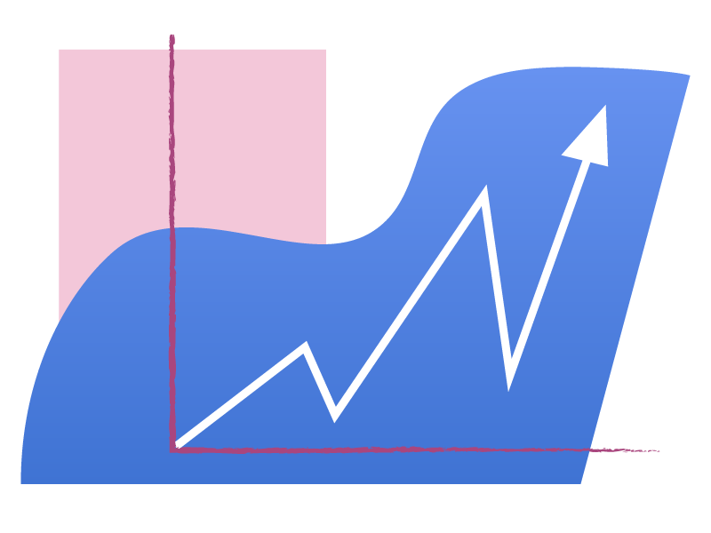

Future Steps
Real-time Data: Check on data in future
Granularity: Go more specific for more insights (i.e. cities, demographics)
Predictions: Forecast trends
Data Quality: Get more comprehensive updated data

Slide 17
Conclusion
Data Analysis:
Historical Perspective: Comprehend the historical evolution of COVID scenario
Dataset: Tried using JSON Dataset (GridFS issue)
Granular Insights: Filtering data by continent, country, date, and age group for detailed understanding
Informed Decision-Making: Derived key insights to effectively address the dynamic nature of the COVID
Key Takeaways:
Project Scope: Navigated the database ecosystem, starting with data retrieval from the COVID website
Data Processing: Pre-processed the acquired dataset to enhance its quality and relevance
Storage Optimization: Efficiently stored in a NoSQL database, ensuring quick and seamless extraction
Visualization and Insights: Leveraging Tableau, we extracted meaningful insights from the data
Seamless Execution: Entire project executed end-to-end, learning database management and analysis

Slide 18
Acknowledgements
Dataset: https://ourworldindata.org/covid-deaths
Dashboard: Referenced the Austin Covid Dashboard
Snowflake Assignment : Exposure to Semi Structured Data Warehousing
Our team for being so cooperative
Professor Joshi for being such a great professor :)

